Slide 1
Fuzzy Logic
Lecture #1
Basic definition & Terminology

Slide 2
The term fuzzy refers to things that are not clear or are vague.
In the real world many times we encounter a situation when we can’t determine whether the state is true or false, their fuzzy logic provides very valuable flexibility for reasoning.
It allows for multiple possible truth values to be processed through the same variable
It mimics how a person would make decisions, only much faster. .
Fuzzy Logic is a form of many-valued logic in which the truth values of variables may be any real number between 0 and 1, instead of just the traditional values of true or false.
Fuzzy Logic is used in a wide range of applications, such as control systems, image processing, natural language processing, medical diagnosis, and artificial intelligence.
The fundamental concept of Fuzzy Logic is the membership function, which defines the degree of membership of an input value to a certain set or category. The membership function is a mapping from an input value to a membership degree between 0 and 1, where 0 represents non-membership and 1 represents full membership.

Slide 3
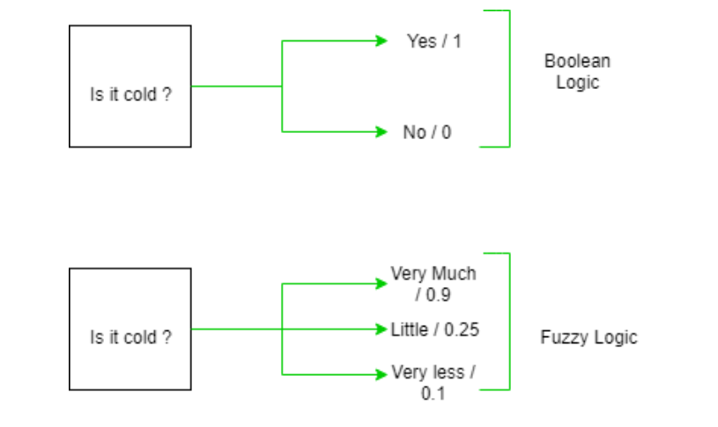
Fuzzy Logic is implemented using Fuzzy Rules, which are if-then statements that express the relationship between input variables and output variables in a fuzzy way.
The output of a Fuzzy Logic system is a fuzzy set, which is a set of membership degrees for each possible output value.
In the boolean system truth value, 1.0 represents the absolute truth value and 0.0 represents the absolute false value. But in the fuzzy system, there is no logic for the absolute truth and absolute false value. But in fuzzy logic, there is an intermediate value too present which is partially true and partially false.

Slide 4
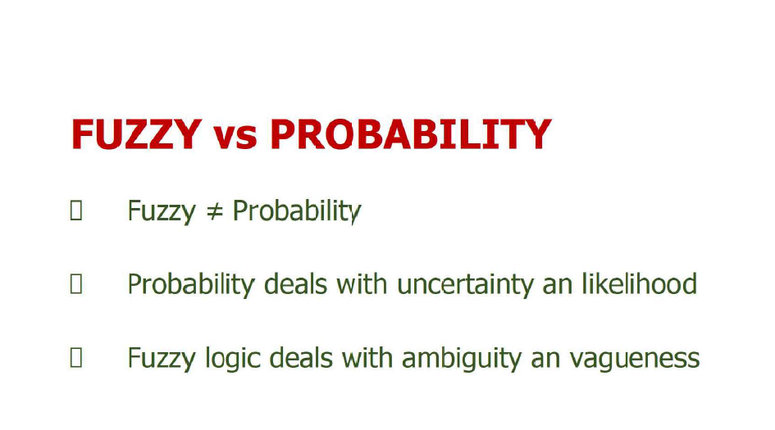
It also used in statistics to reduce the number of features or variables under consideration, while still preserving the essential information present in the data.
This is particularly useful when dealing with datasets with a large number of features, as it can help in simplifying models, reducing computational costs, and often improving generalization performance.
When performing dimensionality reduction, it's important to understand some statistics of the dataset to make informed decisions about which techniques to apply and how they might affect the data.
Benefits-:
Dimension reduction offers several benefits such as-
It compresses the data and thus reduces the storage space requirements.
It reduces the time required for computation since less dimensions require less computation.
It eliminates the redundant features.

Slide 5
Set-theoretic fuzzy operations
Set-theoretic fuzzy operations refer to a set of mathematical operations defined on fuzzy sets, which are sets with elements having degrees of membership ranging between 0 and 1.
These operations are used in fuzzy logic and fuzzy systems to manipulate fuzzy sets and perform various computations. Here are some common set-theoretic fuzzy operations:
1. The union of two fuzzy sets A and B, denoted as A ∪ B, is a fuzzy set where the membership degree of an element in the union is the maximum of its membership degrees in sets A and B. Mathematically, for each element x:
(A ∪ B)(x) = max(A(x), B(x))
2. Intersection (AND): The intersection of two fuzzy sets A and B, denoted as A ∩ B, is a fuzzy set where the membership degree of an element in the intersection is the minimum of its membership degrees in sets A and B. Mathematically, for each element x:
(A ∩ B)(x) = min(A(x), B(x))

Slide 6
Set-theoretic fuzzy operations
Complement (NOT): The complement of a fuzzy set A, denoted as A', is a fuzzy set where the membership degree of an element is the complement of its membership degree in set A (i.e., 1 - membership degree in A).
Mathematically, for each element x:
A'(x) = 1 - A(x)
Difference (SUB): The difference between two fuzzy sets A and B, denoted as A - B, is a fuzzy set where the membership degree of an element is the minimum of its membership degree in set A and the complement of its membership degree in set B.
Mathematically, for each element x:
(A - B)(x) = min(A(x), 1 - B(x))
Intersection and Union Residuum (IUR): The intersection and union residuum between two fuzzy sets A and B, denoted as A △ B and A ▽ B respectively, are defined in terms of their intersection and union operations:
A △ B = A ∩ (B')
A ▽ B = A ∪ (B')
Here, B' denotes the complement of fuzzy set B.

Slide 7
Fuzzy sets and operations on fuzzy sets
Formally, a fuzzy set A in a universe of discourse X is defined by a membership function μ_A(x), which assigns a membership grade μ_A(x) ∈ [0, 1] to each element x in X, indicating the degree to which x belongs to the set A.
Fuzzy logic defines several operations for manipulating fuzzy sets, including union, intersection, complement, and difference. These operations generalize their crisp set counterparts to handle fuzzy membership degrees.
These operations enable fuzzy logic-based reasoning, decision-making, pattern recognition, and control, providing a framework for handling uncertainty, vagueness, and imprecision in computational models and systems.
Fuzzy sets and operations are widely used in applications such as expert systems, fuzzy controllers, pattern recognition, and natural language processing.

Slide 8
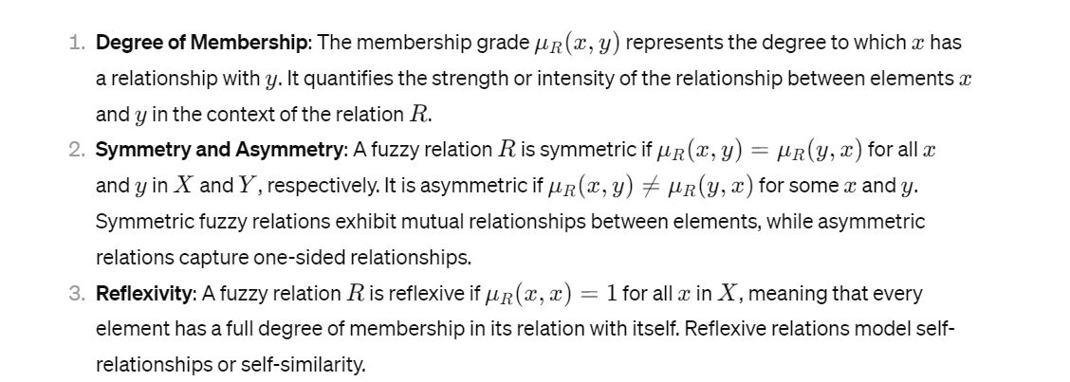
Fuzzy relations
Fuzzy relations are an extension of crisp relations to handle uncertainty and vagueness in the relationships between elements of two sets.
In crisp (or classical) relations, an element either has a specific relationship with another element or does not, whereas in fuzzy relations, the degree to which an element has a particular relationship with another element is described by a membership grade between 0 and 1.
Here are some key concepts and properties of fuzzy relations:

Slide 9
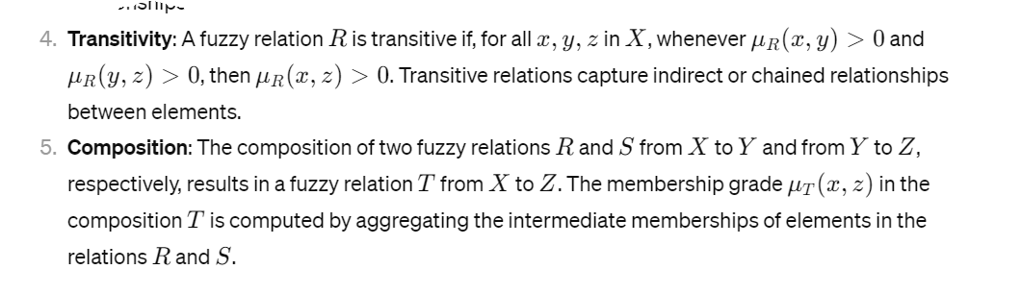
Fuzzy relations
They provide a flexible and expressive framework for modeling complex relationships and reasoning under uncertainty.

Slide 10
Fuzzy reasoning
Fuzzy rules are the building blocks of fuzzy logic systems.
These rules are typically in the form of "if-then" statements, where the "if" part represents the conditions or inputs, and the "then" part represents the conclusions or outputs.
Unlike in classical logic where conditions are either true or false, in fuzzy logic, conditions and conclusions can have degrees of truth between 0 and 1, indicating the degree of membership of an element in a fuzzy set.
Fuzzy reasoning is the process of making decisions or drawing conclusions using fuzzy logic. It involves interpreting fuzzy rules and combining them to derive crisp (non-fuzzy) conclusions. There are various methods of fuzzy reasoning, including:
1. Mamdani fuzzy inference: This method involves applying fuzzy logic rules to fuzzy input values to produce fuzzy output values.
The output values are then defuzzified (process of converting fuzzy output values into crisp (non-fuzzy) values) to obtain crisp results.
defuzzification is an essential step in the application of fuzzy logic, enabling the translation of fuzzy reasoning into practical, actionable outcomes that can be effectively utilized in various real-world domains.

Slide 11
Fuzzy reasoning
2. Sugeno fuzzy inference: Unlike Mamdani, Sugeno inference provides linear or constant output functions for each rule's consequent.
It calculates the weighted average of the output membership functions to derive crisp output values.
3. Fuzzy logic control: Fuzzy logic control systems use fuzzy reasoning to control complex systems with vague or imprecise input-output relationships.
These systems have been successfully applied in various fields, including engineering, finance, and consumer electronics.

Slide 12
FUZZY INFERENCE SYSTEM
Fuzzy inference system is a key unit of fuzzy logic system having decision making as its primary work.
It uses the If –Then rules along with the connectors “Or” and “And” for drawing the essentials decision rules.
If this condition will be satisfied for that problem then this particular rule will be applicable
If at some points two situations are given and both are used to draw the decisions but we can use connectors for taking decision to draw the essentials

Slide 13
FUZZY INFERENCE SYSTEM
The following five rules will help you to understand the construction of FIS
Rule base:-It contains If then rule or that contains different set of rules
Database rule – It defines the membership function of fuzzy set used in fuzzy rules
Decision making unit-It performs operation on rules
Fuzzification interface unit:-It converts the crisp quantities into the fuzzy quantities
DIU- opposite of above one
Fuzzy inference systems are used in various applications, including control systems, decision support systems, pattern recognition, and data analysis, where traditional methods may struggle due to the presence of uncertainty, imprecision, or incomplete information.

Slide 14
Fuzzification and Defuzzification methods
Fuzzification and defuzzification are key processes in fuzzy logic systems, allowing for the conversion of crisp input data into fuzzy sets and the conversion of fuzzy output data into crisp values, respectively. Here are some common methods for both fuzzification and defuzzification:
Fuzzification Methods:
Grade of Membership (GoM): The membership function defines the shape of the fuzzy set, which can be triangular, trapezoidal, Gaussian, etc.
Membership Function: Specifies the degree of membership of an element in a fuzzy set. Common membership functions include triangular, trapezoidal, Gaussian, and sigmoidal functions.
Binary Fuzzification: Assigns a membership value of 1 to the linguistic term that best describes the input value and 0 to all other terms.

Slide 15
Fuzzification and Defuzzification methods
Defuzzification Methods:
Center of Gravity (COG) or Center of Area (COA): Calculates the centroid or center of gravity of the area under the fuzzy output set curve. The crisp output value corresponds to the center of mass of the fuzzy output set.
Mean of Maximum (MOM): Selects the output value corresponding to the linguistic term with the highest membership degree. The crisp output value is determined as the mean of the support of this linguistic term.
Largest of Maximum (LOM): Similar to MOM but selects the output value corresponding to the linguistic term with the highest membership degree directly.

Slide 16
Fuzzy based expert system
A fuzzy logic-based expert system (FLES) is a type of expert system that utilizes fuzzy logic to handle uncertainty and imprecision in knowledge representation and reasoning.
An expert system is a computer program that is designed to solve complex problems and to provide decision-making ability like a human expert. It performs this by extracting knowledge from its knowledge base using the reasoning and inference rules according to the user queries.
knowledge base is a centralized repository for information integrated with artificial intelligence (AI) technologies.
Fuzzy logic allows for the modeling of vague or uncertain information, which makes it particularly useful in situations where traditional binary logic may not be sufficient.
Here are the key components and characteristics of a fuzzy logic-based expert system:
1. Knowledge Base: Like traditional expert systems, FLES relies on a knowledge base that contains rules, facts, and heuristics about the domain being modeled. However, in a FLES, this knowledge is often represented using fuzzy sets, fuzzy rules to handle imprecise data.

Slide 17
Fuzzy based expert system
2. Fuzzification: Fuzzification is the process of converting crisp inputs into fuzzy sets. In a FLES, input data is typically fuzzified to represent the degrees of membership in linguistic variables or fuzzy sets, allowing the system to reason with uncertain or vague information.
3. Inference Engine: The inference engine in a FLES is responsible for reasoning with the fuzzy rules defined in the knowledge base. Fuzzy inference mechanisms such as fuzzy logic operations (AND, OR, NOT), fuzzy reasoning methods (Mamdani, Sugeno), and fuzzy reasoning algorithms are used to derive conclusions based on the fuzzy input data and rules.
4. Defuzzification: Once the inference process is complete, the fuzzy outputs need to be converted back into crisp values. Defuzzification methods, such as centroid or weighted average, are used to determine the most appropriate crisp output based on the fuzzy conclusions derived from the inference engine.

Slide 18
Fuzzy based expert system
5. Uncertainty Handling: Fuzzy logic allows for the representation and handling of uncertainty in the knowledge base and reasoning process. Fuzzy sets and fuzzy rules provide a way to express uncertainty and vagueness in a more natural and intuitive manner than traditional crisp logic.
Overall, fuzzy logic-based expert systems provide a flexible and robust framework for modeling and reasoning with uncertain and imprecise knowledge, making them valuable tools in domains where traditional expert systems may fall short.

